Slide 1


Big Trends in Big Data & Analytics
AKA “What I personally find interesting”
Timo Elliott
VP, Global Innovation Evangelist

Slide 2

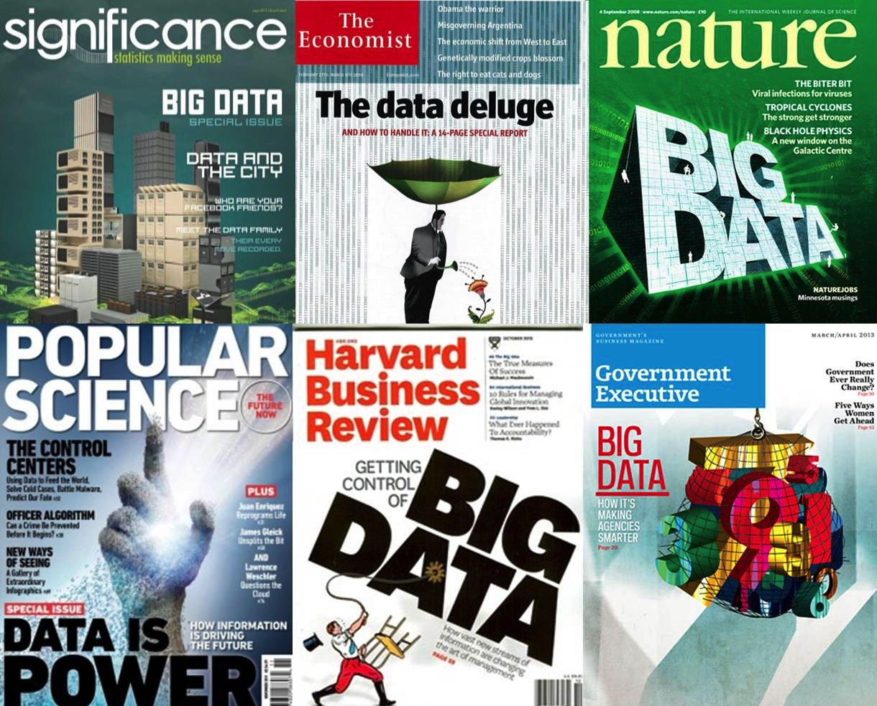
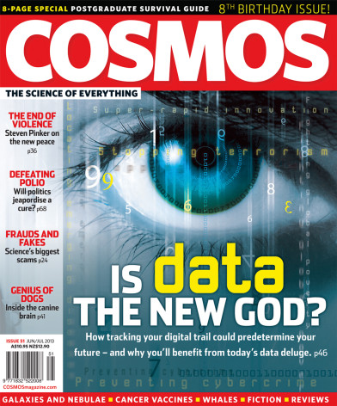
Congratulations!
YOU WON

Slide 3


How Do Executives Make Decisions?
Aspect Consulting, 1997
Economist Intelligence Unit, 2014
12%
10%
Hard Facts
Hard Facts
88%
90%
Gut Feel
Gut Feel
Why the worst-practice shaded 3D donut charts? JUST TO ANNOY DATA VIZ EXPERTS! ☺

Slide 4
Biggest Barriers to Business Intelligence
2003
2015
Sources: InformationWeek Survey 2015, BusinessWeek Survey, 2003

Slide 5
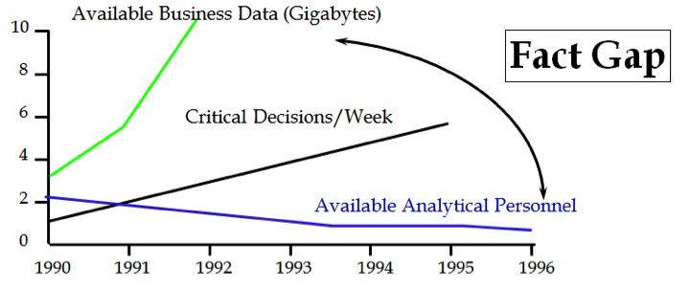
Plus Ça Change…
Petabytes
+ IoT
Big Data
Data Scientists

Slide 6
Business Intelligence Success…
?
Sources: InformationWeek Survey 2015, BusinessWeek Survey, 2003

Slide 7
The Opportunity
Inaccessible data and technology
Insights remain hidden
Use Analytics Today
Silos of approaches and analytic technologies
Complexity, cost, confusion
10%
Rear view mirror BI mentality
Slow decision making lacking future view
75%
Need Analytics by 2020
Gartner, 2014
Inability to see, understand, and optimize new opportunities

Slide 8
There’s Been An Explosion of New Technology
MORE!
speed
data
cloud
connected
competition
mobile
social
Means new opportunities…

Slide 9

Big Data
=
Big Data Discovery
Data Discovery
Data Science
Gartner Strategic Planning Assumption: By 2017, Big Data Discovery Will Evolve Into a Distinct Market Category

Slide 10
Big Data Discovery
Volume, velocity, or variety of data
Potential business impact
Complexity of analysis
Potential impact
Range of tools
Smart algorithms
BIG
DATA
DATA
SCIENCE
Difficult to implement
Slow and complex
Narrow focus of analysis
Difficult to implement
Potentially expensive
Lack of skills available
DATA
DISCOVERY
Ease of use
Agility and flexibility
Time-to-results
Installed user base
Limited depth of information exploration
Low complexity of analysis

Slide 11
Big Data Discovery
Simpler to use than data science
Accessible to a wider range of users
Broad range of data manipulation features
Able to handle new types of data sources
With adequate performance for big data
BIG
DATA
DISCOVERY

Slide 12
The Rise of the Citizen Data Scientist?
Potential user base
Citizen data scientist
Potential impact per user
Business analyst
Data scientist

Slide 13
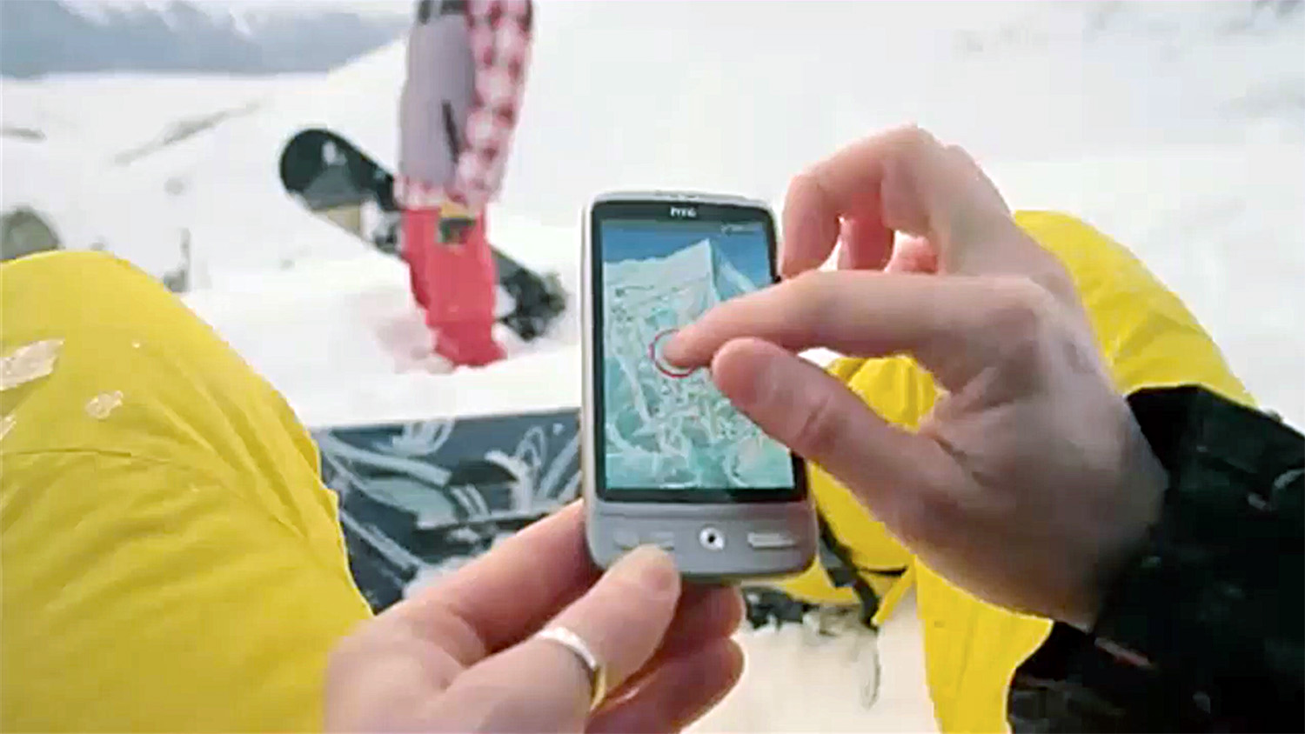
New Products & Services

Slide 14
The Opportunity
Data Value
Data Discovery
“Big Data Discovery”
Big Data
Data Science
New Business Opportunities
Traditional Analytics
Volume / Variety / Velocity of Data

Slide 15
SAP’s Opportunity
SAP HANA
(+ Hadoop etc.)
SAP Predictive Analytics 2.0
Big
Data
Discovery
SAP Lumira

Slide 16
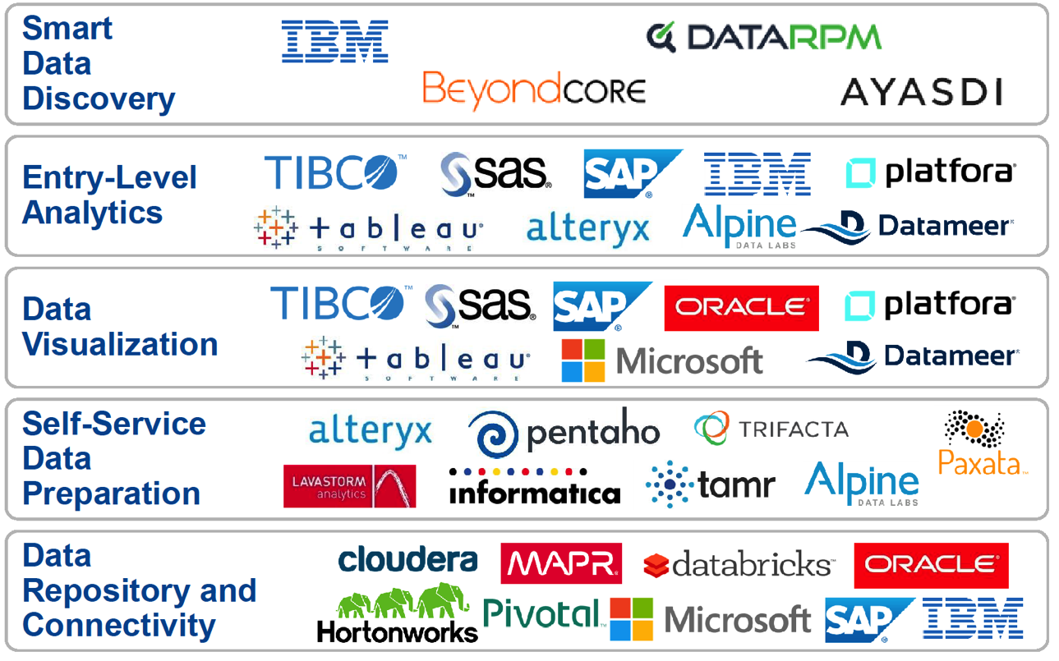
The Landscape is Converging

Slide 17
May Imply Differently Sliced Products?
Example only — not a product plan!
ETL
BI
Q&R
OLAP
Predictive
Big Data Discovery Advanced
Big Data Discovery Team
Big Data Discovery Basic

Slide 18
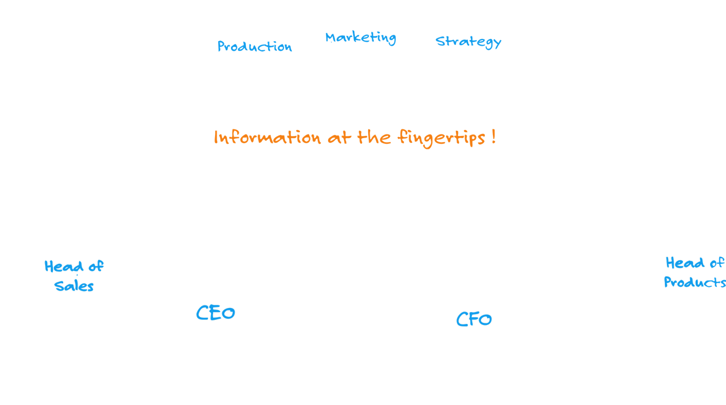
Boardroom Redefined
Source:
In-Memory Data Management: An Inflection Point for Enterprise Applications.
Hasso Plattner Alexander Zeier

Slide 19




“Intricate calculations of sales by territories will appear as if by magic in the digital age ahead”

Slide 20

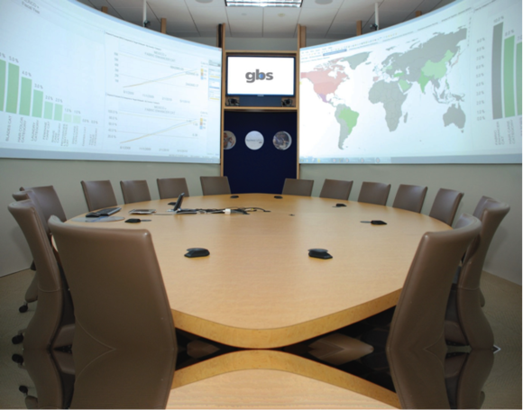
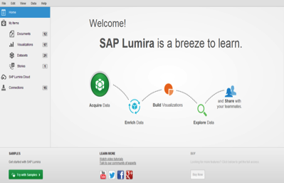
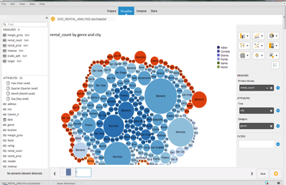
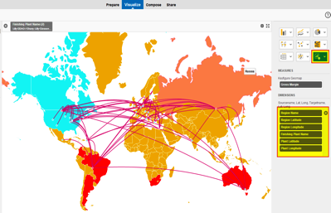
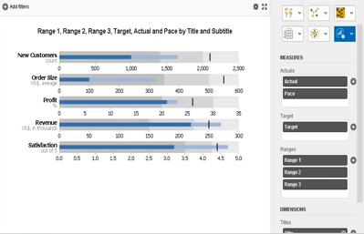
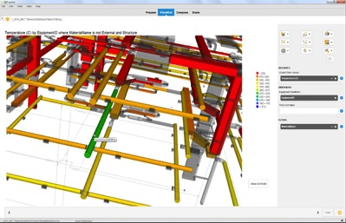
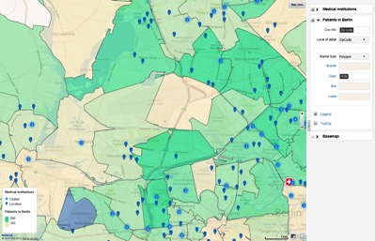
Decision Cockpits

Slide 21
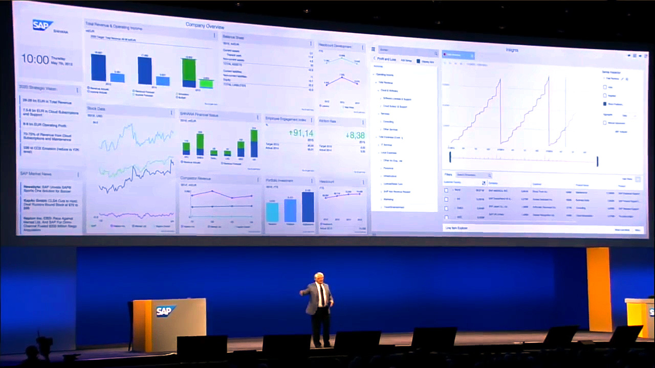
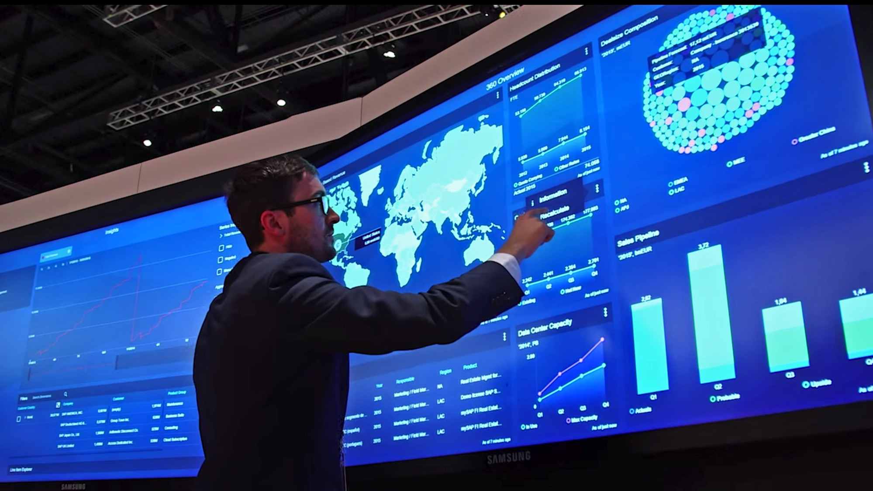
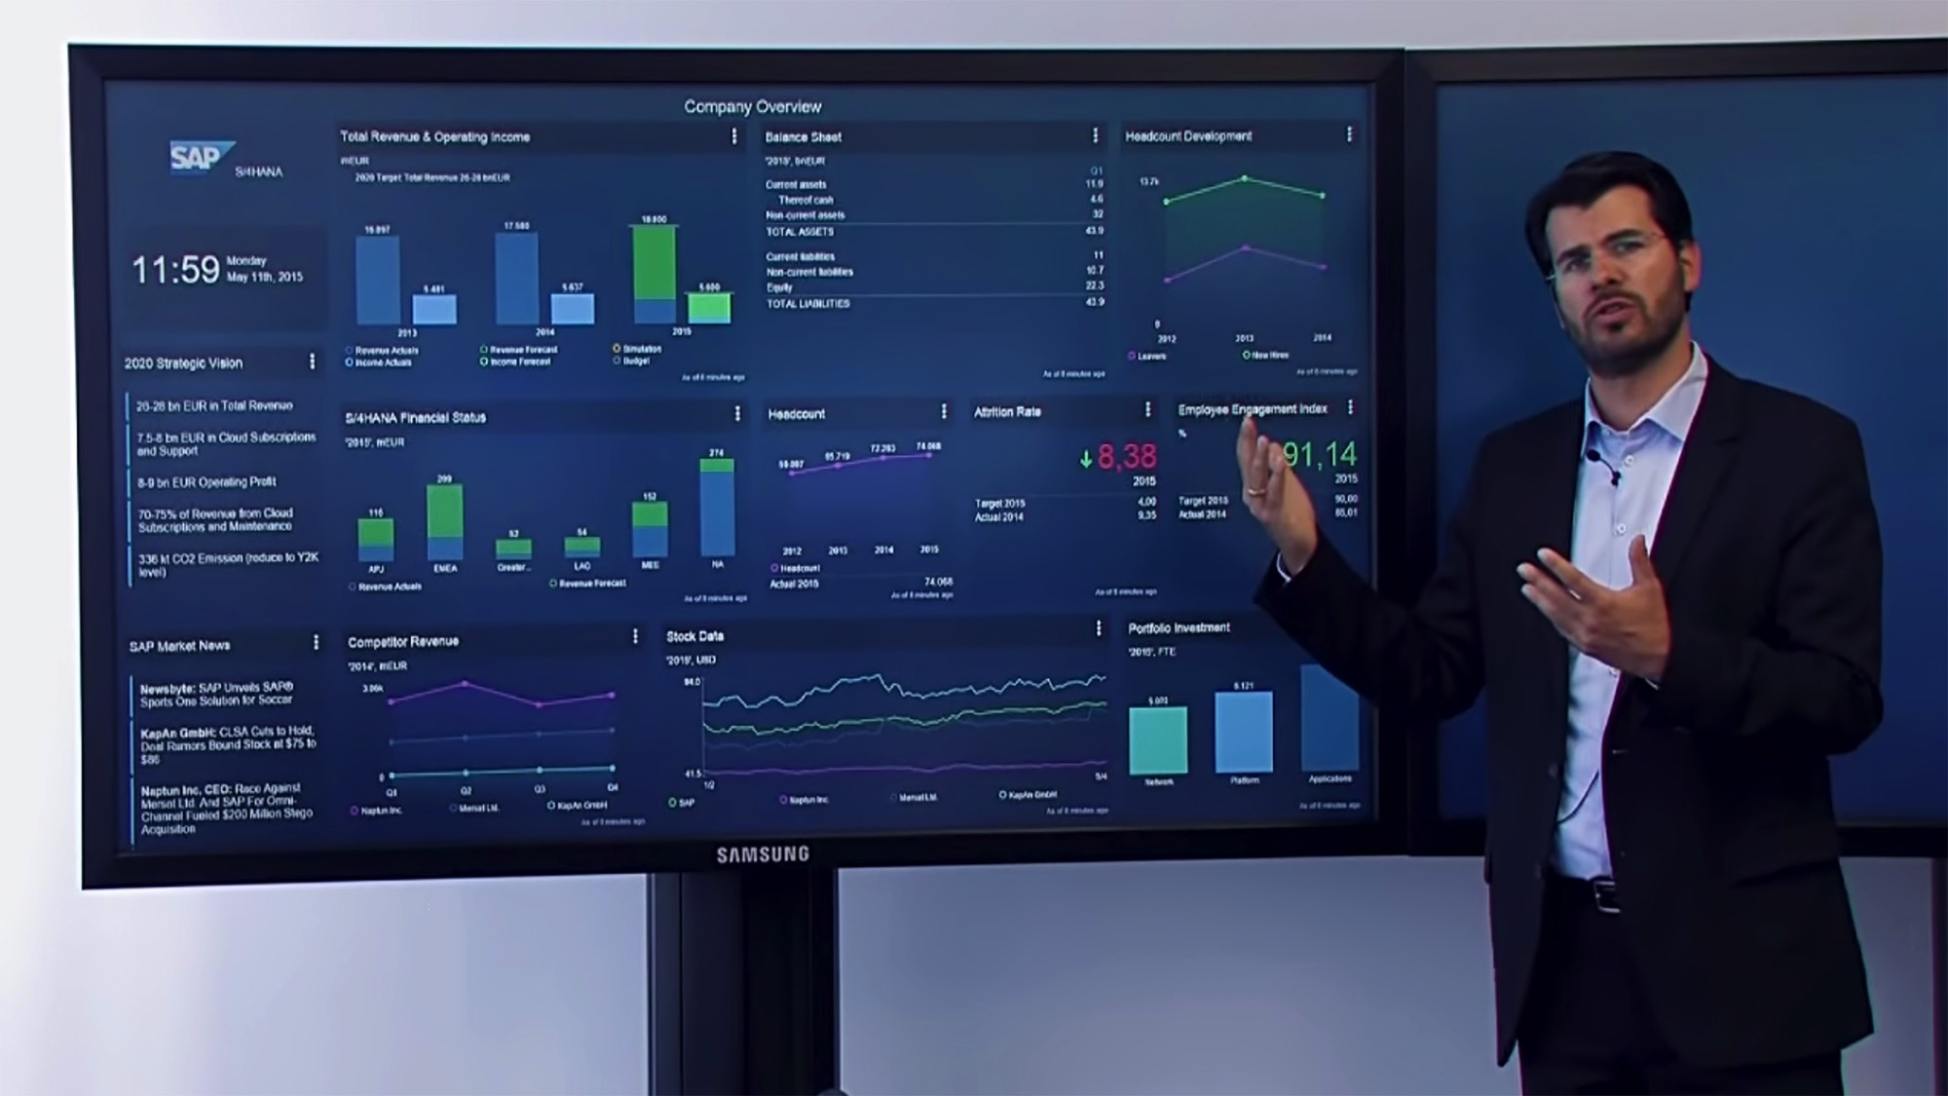

Slide 22

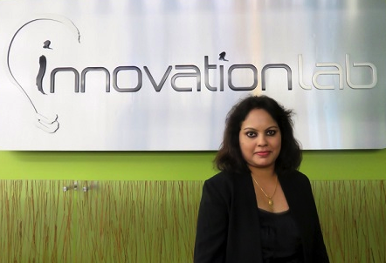
Wal-Mart’s Data Café (“Collaborative Analytics Facilities for Enterprise”)
“In-memory cannot economically, or even practically, scale to the volumes of today’s data warehouses — Neil Raden, 2012”
Data from 245M customers/week, 11,000 stores under 71 banners in 27 countries and e-commerce websites in 11 countries with $482.2 Bn sales and 2.2M employees.
250 Bn rows of data
94% of queries run < 2s
>1,000 concurrent users even under heavy loads.
Data load throughput >20 million records/hour
Suja Chandrasekaran CTO of Walmart Technology

Slide 23




Mercy Health
Mercy Named One of Nation’s Most Wired for 11th Year
40K employees, >8M patients/year, 9 years of data, structured & unstructured

Slide 24
Hadoop Rising (?)
1Q 2013
1Q 2015
1Q 2014

Slide 25
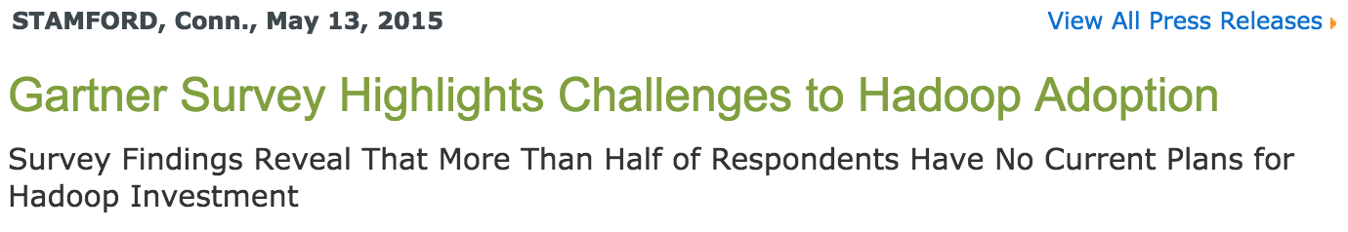
The End of the Hadoop Honeymoon?
"Despite considerable hype and reported successes for early adopters, 54% of survey respondents report no plans to invest at this time, while only 18%have plans to invest in Hadoop over the next two years. Furthermore, the early adopters don't appear to be championing for substantial Hadoop adoption over the next 24 months; in fact, there are fewer who plan to begin in the next two years than already have.”
Nick Heudecker, research director at Gartner.

Slide 26






































SAP, Open Source & Hadoop
SAP Contributes to over 100 Open Source Projects

Slide 27
















Bringing Enterprise Data to Hadoop and Hadoop Data to The Enterprise
Mobile applications and BI
CONSUME
High Performance Applications
Business Planning & Forecasting
Reporting &
Dashboards
Adhoc & OLAP Analytics
Data Exploration
& Visualization
Predictive Analysis
Lumira / BI
SAP HANA Platform
Hadoop / NoSQL
COMPUTE
Application Development Environment
STREAM PROCESSING
ANALYTICS, TEXT, GRAPH, PREDICTIVE ENGINES
SPATIAL PROCESSING
In-Memory
Calculation engine
Column Storage
Series Data Storage
Dynamic Tiering
STORAGE
Data model & data
Fast computing
High performance analytics
Store time- series data
Aged data in Disk
MapReduce
Smart Data Streaming
Smart Data Access
Smart Data Integration Smart Data Quality
YARN
INGEST
101010010101101001110
HDFS
Stream Processing
Virtual Tables
User Defined Functions
Transformations & Cleansing
SOURCE
ERP
OLTP
Geo
Store & forward
Text
Social
Logs
Machine
Sensor
But there is more work to do…

Slide 28

The New Multi-Polar World of Big Data Architectures
Data Warehouse
Hadoop,
MongoDB,
Spark, etc
Hybrid Transaction/Analytical Processing
Personal
Data / BI
Where does data arrive?
When does it need to move?
Where does modeling happen?
What can users do themselves?
What governance is required?
Big Data Architectures got complicated
What we want — consistent, seamless solution

Slide 29
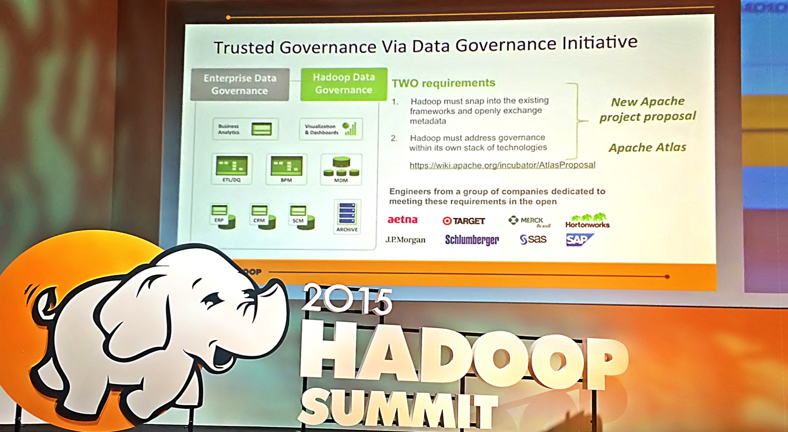
Apache Atlas

Slide 30

Data Wrangling Eats Into ETL
“Self-service data integration will do for traditional IT-centric data integration what data discovery platforms have done for traditional IT-centric BI… shifting much of the activity from IT to the business user”
Rita Sallam, Gartner Analyst
“We had a short period of time to complete a massive data migration project which required us to extract, organize and clean 30 million records being moved from a legacy environment into an SAP system”
Matt Heinz, Head of BI at Del Monte Foods, Inc.

Slide 31
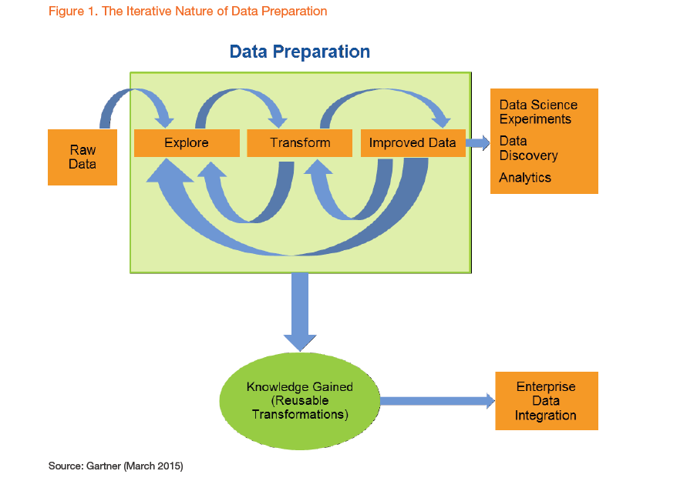
Data Preparation is a Highly Iterative and Time-consuming Process Commonly accepted that ~80% of the work on data analytics is in preparation

Slide 32
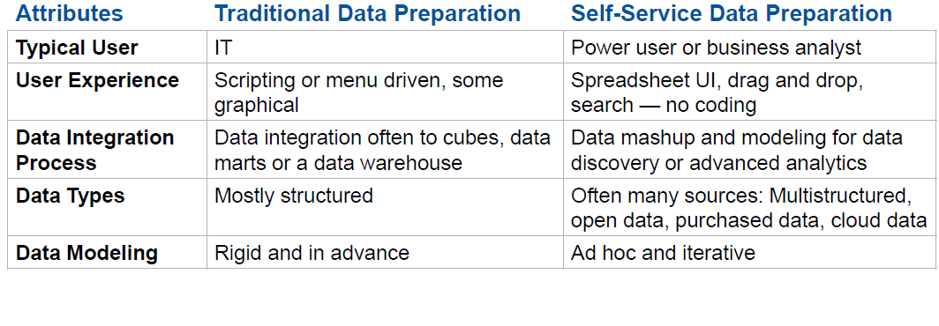
Self-service Data Preparation Tools Reduce the Time and Complexity of Preparing the Data
Gartner predicts by 2018 most business users will have access to self-service tools to prepare data for analytics
Source: Gartner

Slide 33
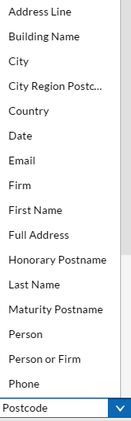
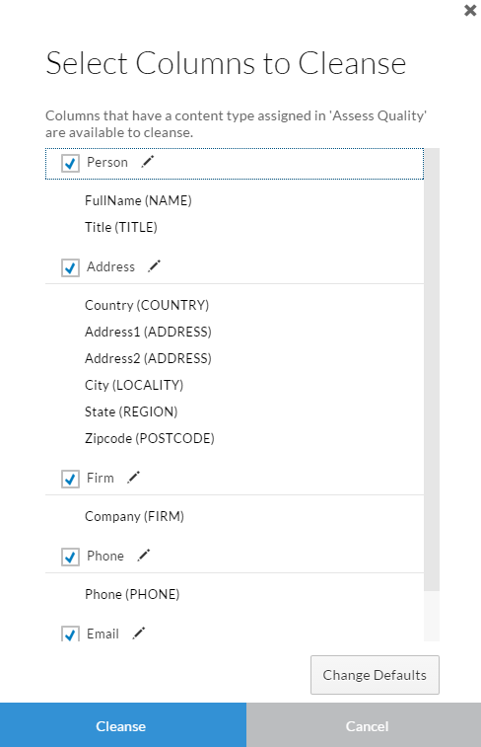
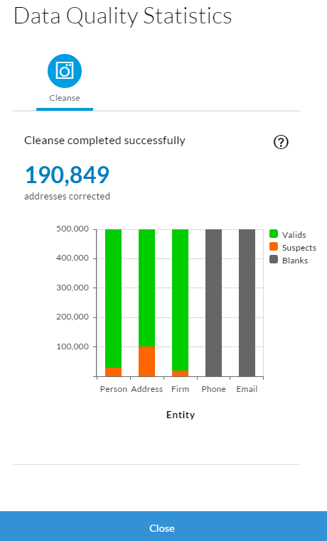
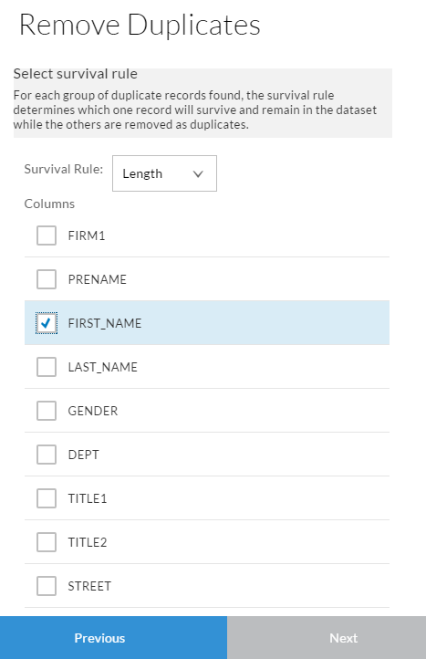
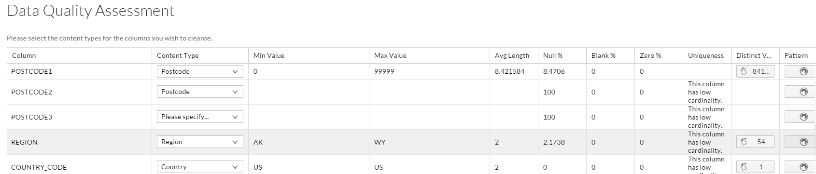
SAP Agile Data Preparation: Cleanse

Slide 34
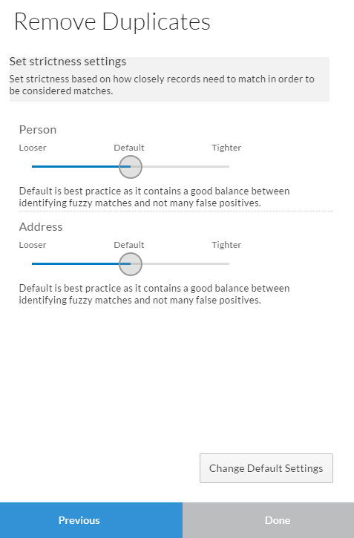
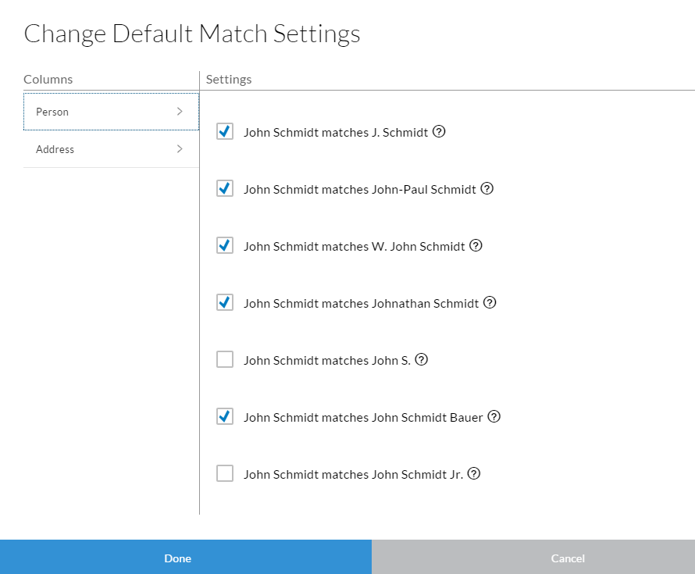
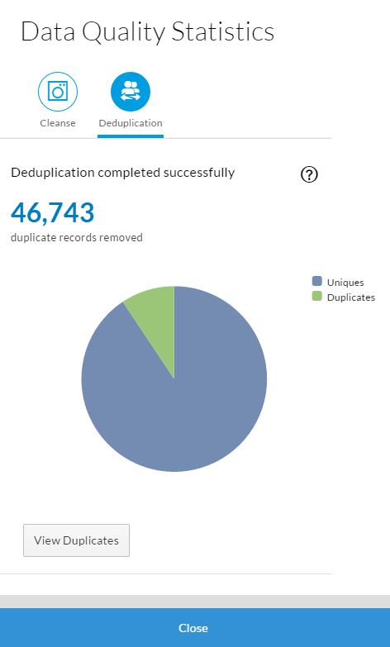
SAP Agile Data Preparation: De-Duplicate

Slide 35
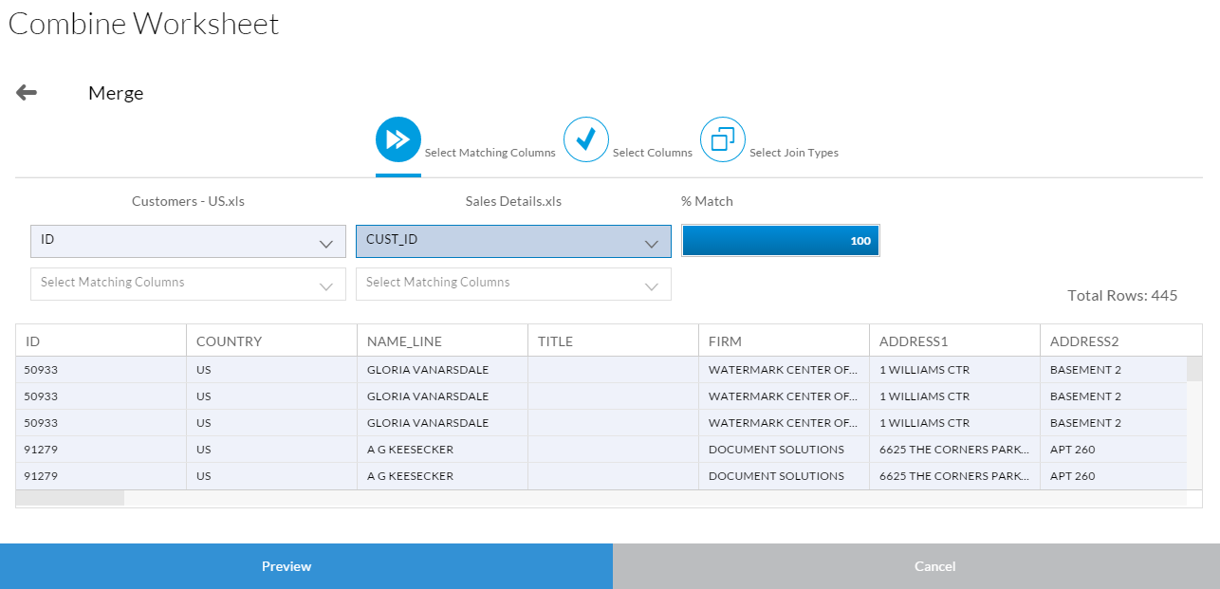
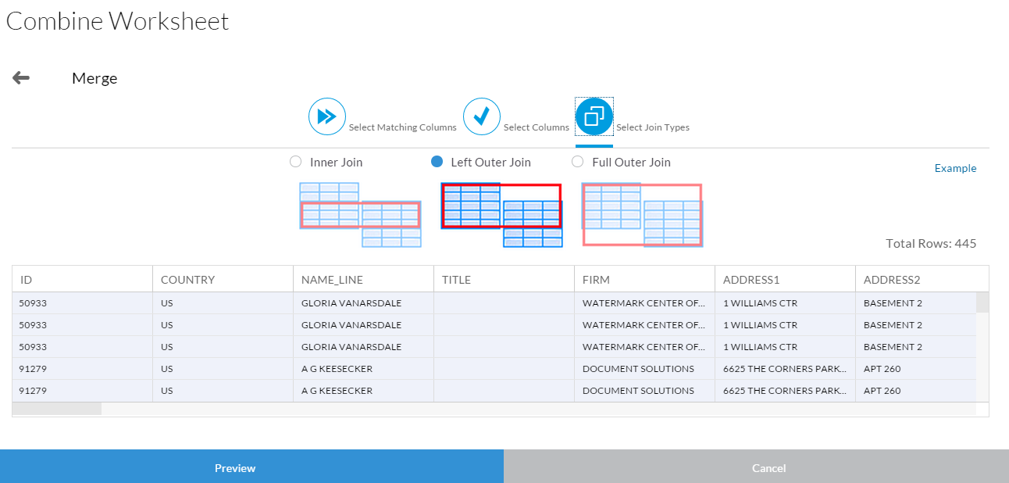
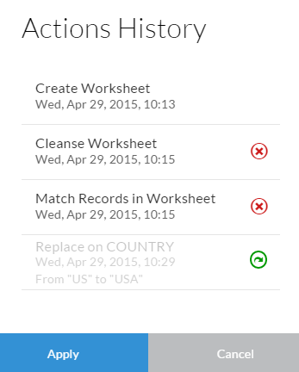
SAP Agile Data Preparation: Merge

Slide 36
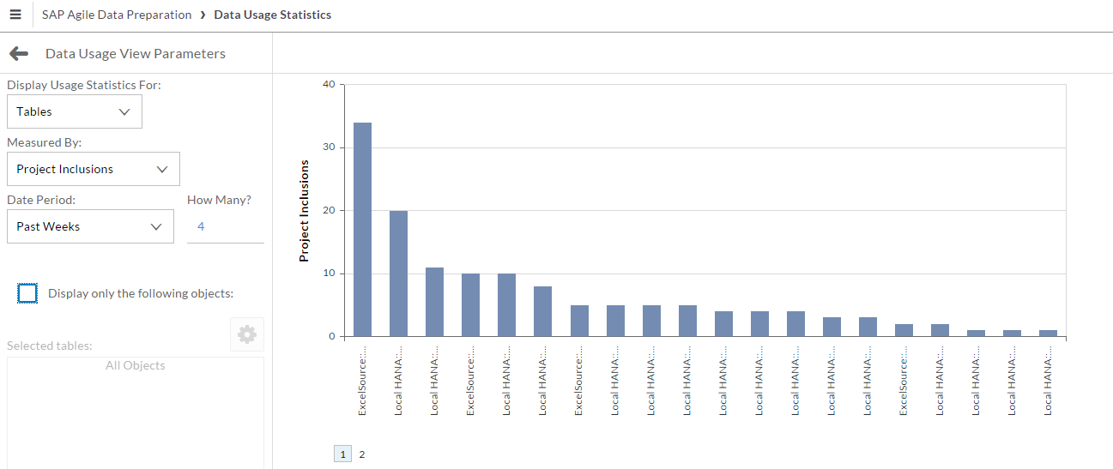
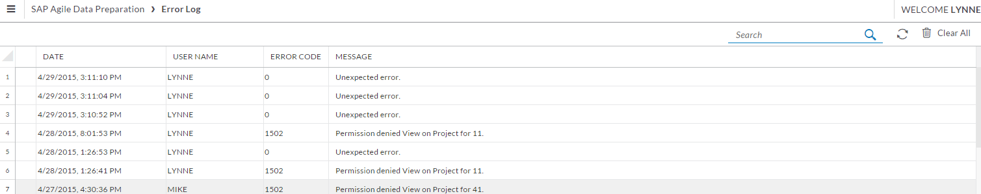
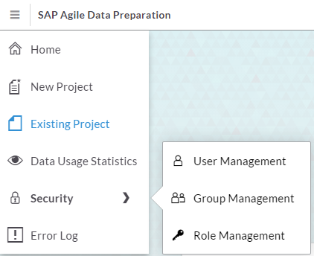
SAP Agile Data Preparation: Admin

Slide 37
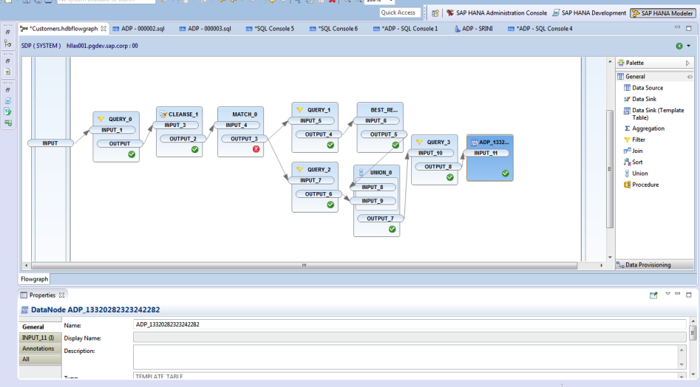
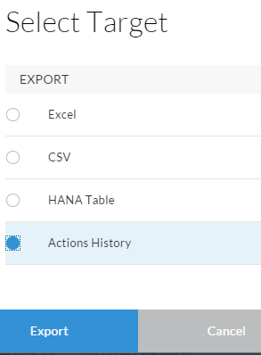
SAP Agile Data Preparation: Operationalize
Export Action History and Import as a flowgraph in HANA EIM

Slide 38

Data Visualization is Cool… (but)
Importance for BI Success of:
Not using pie charts
Ease of use, training, data quality, incentives, organization, process, etc. etc.

Slide 39
We Still Need Reporting and Dashboards!
Question: “To what extent are the following technologies used to share analytic and BI insights within your organization?” and response: “Used Extensively”
Source: InformationWeek BI Survey 2015

Slide 40

We Need To Support The Analytics Lifecycle

Slide 41

Taking Analytics To The Next Level
Prescriptive:
How can we make it happen?
Predictive:
What will happen?
Diagnostic:
Why did it happen?
Descriptive:
What happened?
Hindsight
Insight
Foresight

Slide 42

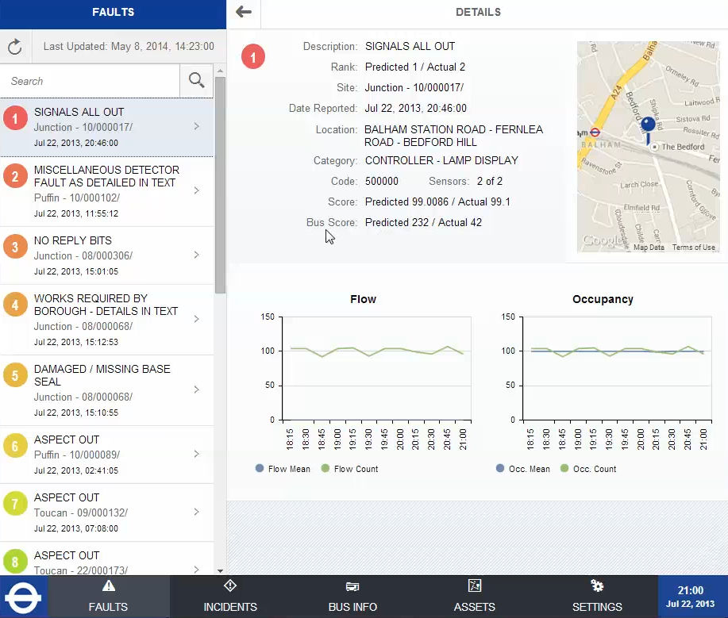
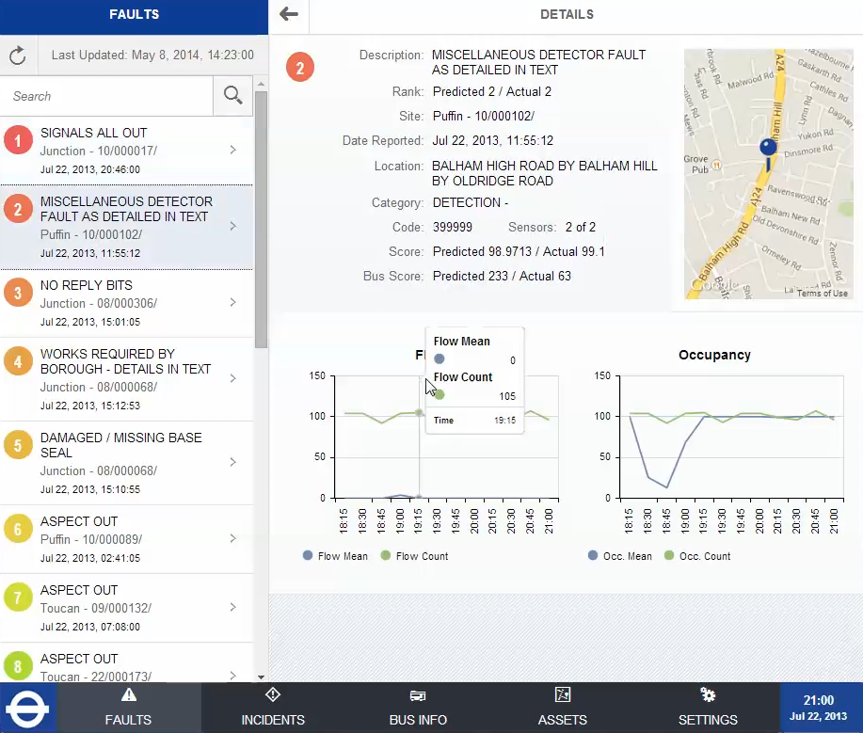
Transport For London

Slide 43



Centerpoint Energy

Slide 44

These numbers were found in two tax declarations. One is entirely made up. Which one?
Benford's Law, also called the First-Digit Law
DATA SCIENCE
QUIZ.
EUR
127,-
2.863,-
10.983,-
694,-
29.309,-
32,-
843,-
119.846,-
18.744,-
1.946,-
275,-
EUR
937,-
82.654,-
18.465,-
725,-
98.832,-
7.363,-
4.538,-
38,-
8.327,-
482,-
2.945,-

Slide 45
Benford’s Law
Distribution of the first digit of real-world sets of numbers that uniformly span several orders of magnitude

Slide 46

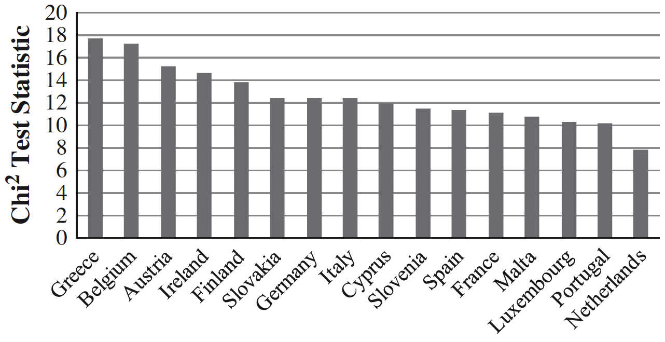
1999 to 2009
“Greece shows the largest deviation from Benford’s law with respect to all measures. [And] the suspicion of manipulating data has officially been confirmed by the European Commission.”
Fact and Fiction in EU-GovernmentalEconomic Data, 2011

Slide 47
Big Data looks Beyond
Sales of two new products six weeks after market introduction
Repeat purchases
A
B

Slide 48

Kaeser Compressors
Enabling Predictive Maintenance
A global leader in air compressors
≈€500 million, 4,800 employees, 50 countries, partners in additional 60 countries

Slide 49
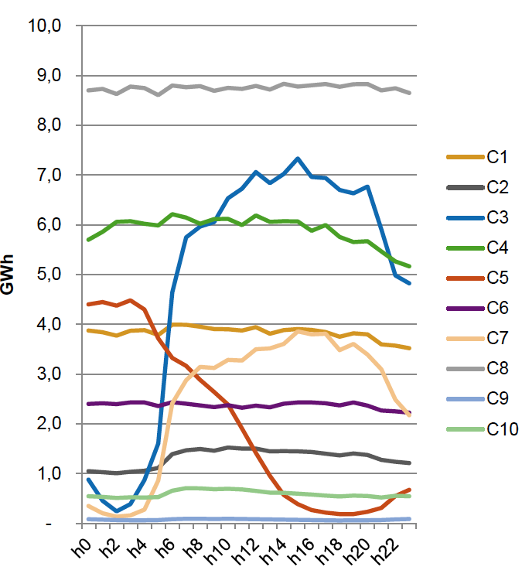
Modeling Example
E.g. Total energy consumption
Aggregation of 10 sec values
Calculation of typical consumption patterns
Pattern associated with each compressor and day
Repeat for temperature, pressure, vibration, etc.

Slide 50
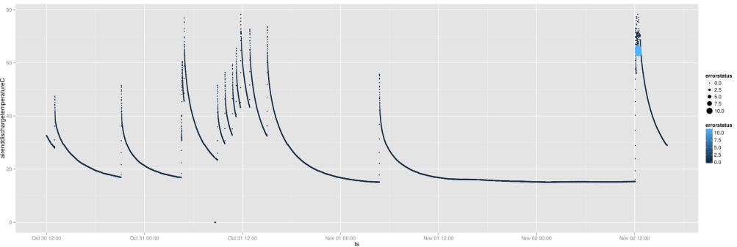
Predictive Examples
Model combines sensor readings and ERP data (location, type of usage, last service, etc.)
Status alerts: “Oil change / oil analyze / no action”
Predict machine failure 24 hours in advance

Slide 51

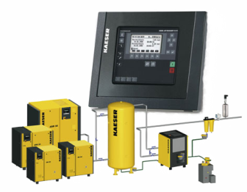
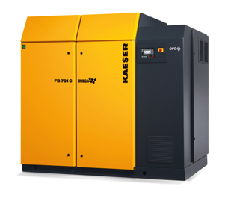
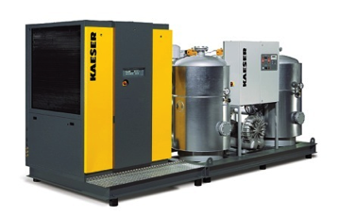

High-Level Technical View
Customer
Field Svs
Sales
R&D
User Interfaces
CRM ERP
Long-term disk storage
Predictive Model (in-memory)
DW
all
sampled
Event Stream Processing

Slide 52
Benefits
Customers
Less downtime
Decreased time to resolution
Optimal longevity and performance
Kaeser
More efficient use of spare parts, etc
New sales opportunities
Better product development
“We are seeing improved uptime of equipment, decreased time to resolution, reduced operational risks and accelerated innovation cycles. Most importantly, we have been able to align our products and services more closely with our customers’ needs.”
Kaeser CIO
Falko Lameter
Next Steps: New Business Models

Slide 53



SAP HANA Cloud Platform - the Internet of Things enabled in-memory platform-as-a-service
Machine Cloud (SAP)
End Customer (On site)
IoT Applications
(SAP, Partner and Custom apps)
Business owner (SAP Customer)
HANA Cloud IoT Services
HANA Cloud Integration
Machine Integration
Data Processing
Process Integration
Device
SAP Connector
Business Suite Systems (ERP, CRM , etc.)
HANA Cloud Platform
Extended Storage
Hadoop
HANA Big Data Platform
In-Memory
Engines
∞
Storage
Streaming

Slide 54



SIEMENS Cloud for Industry
The SIEMENS ‘Cloud for Industry’ connects the worlds of machines and business via:
the HCP for IoT
open APIs
easy connectivity.
It is the successor of the SIEMENS Plant Data Services.
It is planned to be an open platform:
Open to non-Siemens assets and non-SAP back-ends
Endorsing the OPC UA Standards
Creating a separate, yet adjacent & complementary partner developer network
R&D
Sales
Supply Chain
Manufacturing
Aftermarket Service
Business Process Integration (SIEMENS or SIEMENS customers)
SIEMENS Applications
Partner Applications
Customer Applications
SAP Applications
In-Memory Cloud Platform for the Internet of Things
SIEMENS Connectivity
Partner Connectivity
Customer Connectivity
SAP Connectivity
Cloud for Industry
Machine connectivity to SIEMENS customers plants

Slide 55


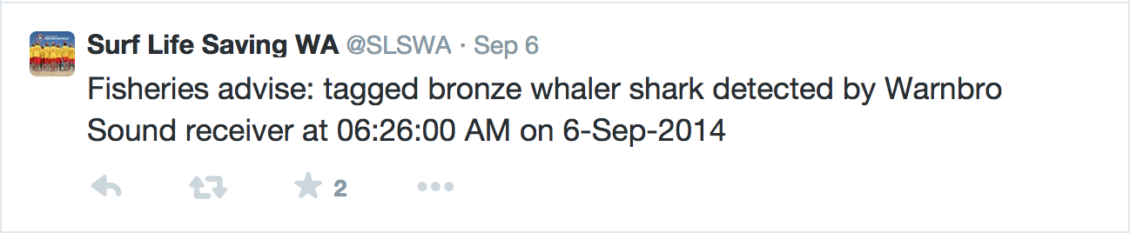
Tweeting Sharks!

Slide 56
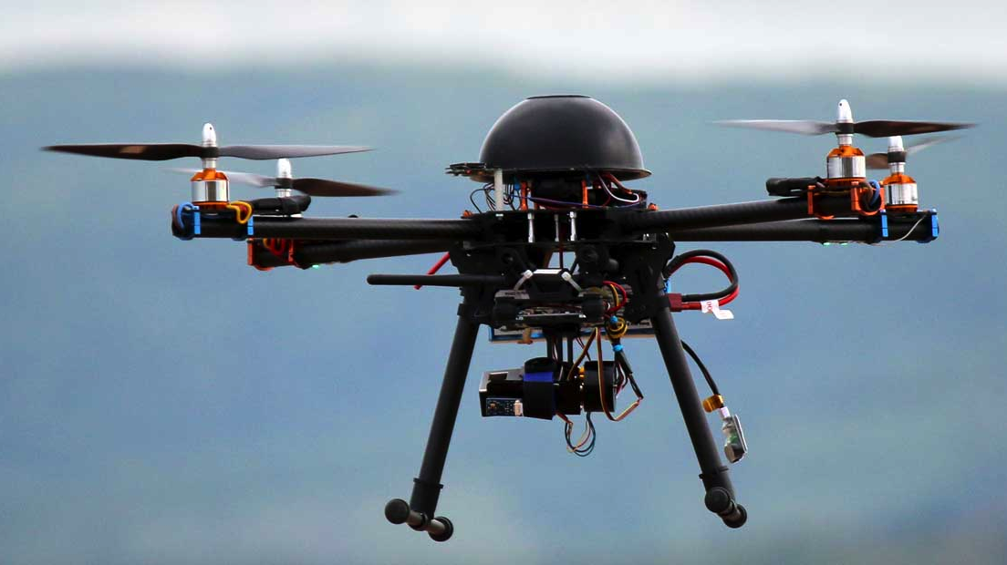
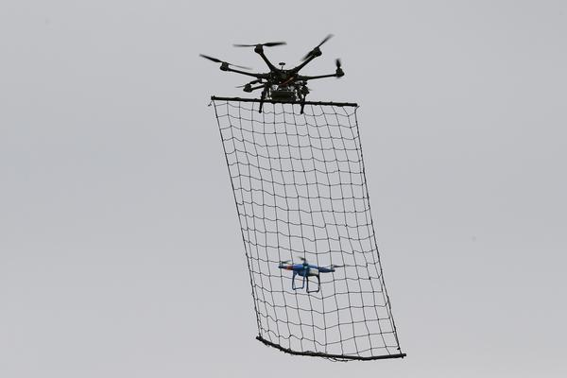
Drones

Slide 57

Time to Reach For The Clouds?

Slide 58





Finance & Analytics: It’s Déjà Vu All Over Again
Discover
Predictive Analytics
Governance, Risk, and Compliance
Any Device
Cloud
Anticipate
Real-time Business
Plan
Business Intelligence
Enterprise Performance Management
100101110111011010010100101101010110 00101011001010010101010001001001011010
Social Collaboration
Big Data
Inform

Slide 59

Is This Your Finance Team?
"With 90% certainty, here’s where we closed last month…"

Slide 60
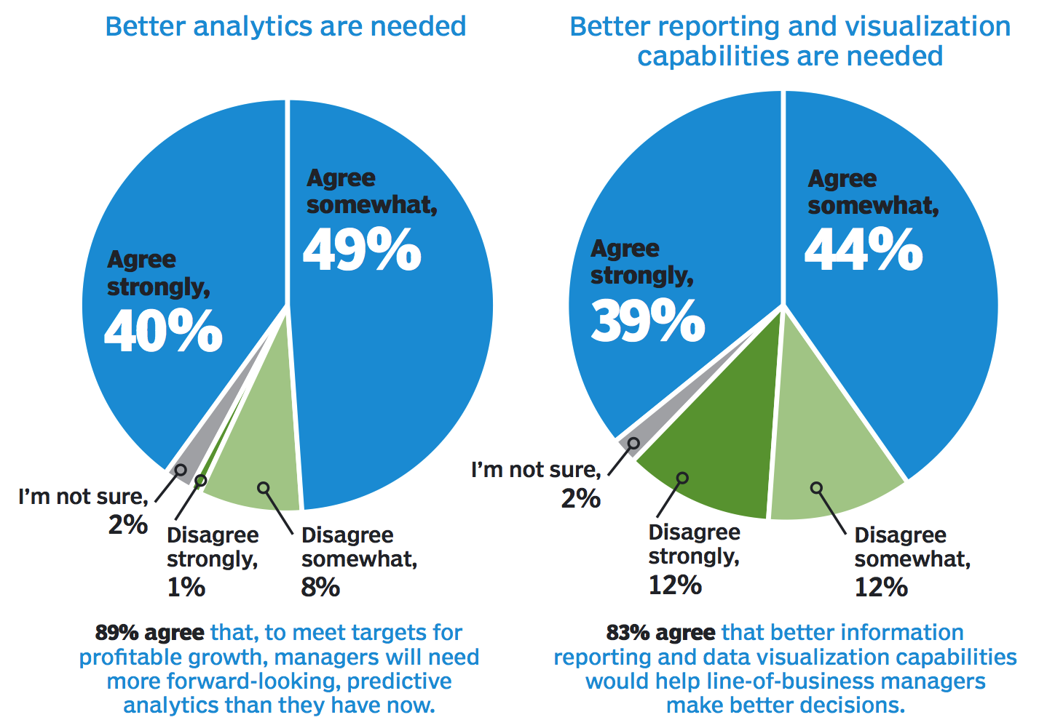
Finance wants to be a business partner.
And that requires better, more forward-looking data.

Slide 61
Rise of the Ops People*
BEFORE
NOW
How are you feeling about the quarter?
Pipeline coverage is at 2.5x. The rep-level forecast implies a result of 105% of plan. The stage and category forecasts are between 99% and 104%. So, Good.
Good.
* Source: Dave Kellogg, Ex CMO of BusinessObjects, now CEO of Cloud EPM Vendor Host Analytics!

Slide 62
Ops People Everywhere = Financial & Analytics
CEO
Sales
Marketing
Services
SalesOps
MarketingOps
ServicesOps
“What’s the impact on the results if we hire 10 more sales people in the UK?”
Ops People:
Modeling
Planning
Budgeting
Reporting
Analysis

Slide 63
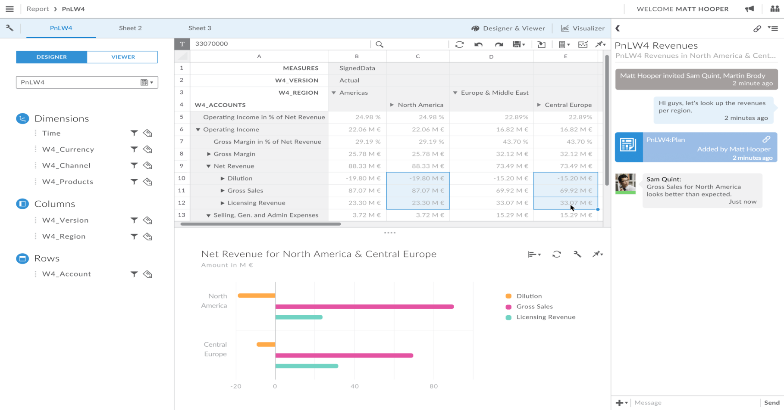
Planning For The Rest of Us

Slide 64
It’s Not You, It’s Your Data…
“We found, on average, that 45% of the data business people use resides outside of the enterprise BI environments.
An astonishingly miniscule 2% of business decision-makers reported using solely enterprise BI applications.
This is undoubtedly connected to 76% of business respondents indicating they continue to resort to spreadsheets and other homegrown BI applications to analyze BI data. ”
Source: Forrester

Slide 65

Suits vs. Hoodies

Slide 66

Advanced Governance
Central IT no longer has a veto — you need the “consent of the governed”
This means you have to behave more like a politician…
Vote for my policies!

Slide 67

Build and Nurture a Community
Regular face-to-face meetings
Bring people together across silos: IT, Analysts, Business Leaders, Execs
Presentations of successes best practices
Invite external speakers
Virtual communities
Leverage internal social tools for people to share information
Community-driven BI content
Community self-policing
Act as BICC eyes and ears to discover projects, opportunities
Social mechanisms to ensure the “right behaviors”
Ensure support at all levels
Not just executives — middle and users

Slide 68
Conclusion: There’s a LOT Going On in Analytics
The future of the boardroom (finally)
SAP HANA & Hadoop
Multi-polar big data architectures
Self-service data preparation
Supporting the analytics lifecycle
Prescriptive and predictive analytics
Internet of things for business
Big data discovery
Finance and analytics converge (again)
Analytics culture & governance

Slide 69
“Judge a man by his questions rather than his answers.”
Voltaire
“Status Quo is, you know, latin for “the mess we’re in”
Ronald Reagan
“Any intelligent fool can make things bigger and more complex. It takes a touch of genius and a lot of courage to move in the opposite direction.”
E.F. Schumacher

Slide 70

Thank You!
timoelliott.com/docs/UKISUG_top_analytic_trends.zip
Timo Elliott
VP, Global innovation Evangelist
Timo.Elliott@sap.com
@timoelliott

